Slide 1


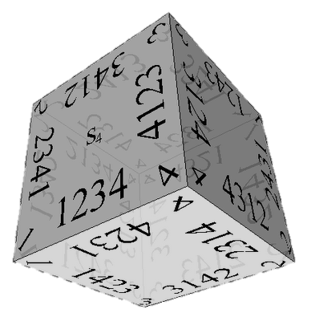

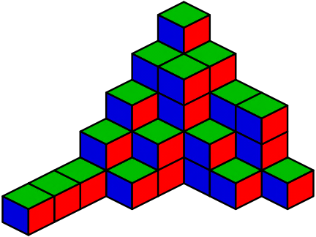
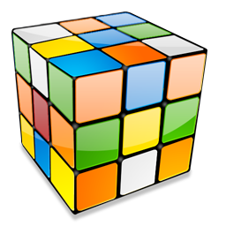
Combinatorial Algorithms
Generating Variations, Permutations, Combinations, …
Combinatorial Algorithms
SoftUni Team
Technical Trainers
Software University
http://softuni.bg

Slide 2
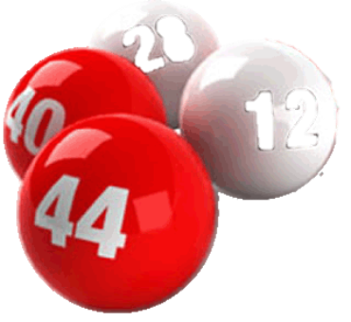



Table of Contents
Definitions in Combinatorics
Generating Variations
Generating Permutations
Generating Combinations
Binomial Coefficients and Pascal's Triangle
Binary Vectors and Gray Code

Slide 3
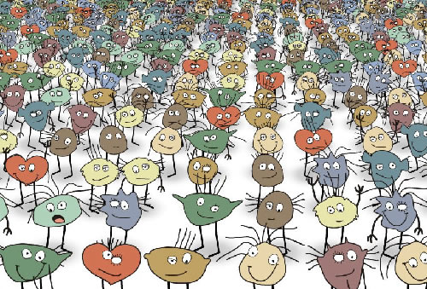


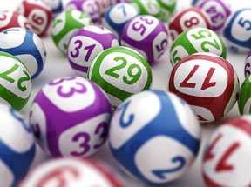
Definitions in Combinatorics

Slide 4
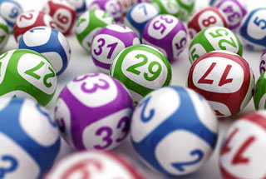
Combinatorics
Combinatorics is a branch of mathematics
Study of countable discrete structures
Combinatorial problems arise in many areas of mathematics / other sciences
Notably in algebra, probability theory, statistics, topology, geometry, physics, chemistry, biology, gambling games, etc.
Programmer's combinatorics concerns generating combinatorial structures

Slide 5
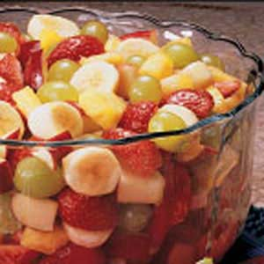
Definitions: Combinations
A combination is a way of selecting items from a collection
Such that the order of the items does not matter
Example: "A fruit salad is a combination of grapes, strawberries and bananas"
We don't care what order the fruits are in
"bananas, grapes and strawberries" or "grapes, bananas and strawberries" → it is the same salad
If the order doesn't matter → combination
E.g. select 3 fruits (in any order) from a collection of 10 kinds of fruits

Slide 6
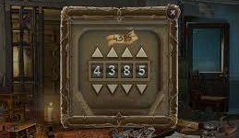
Definitions: Permutations and Variations
A permutation is a rearrangement of the items from a collection
A variation (permuted combination) is
A way of selecting items from a collection
Such that the order of the items matters
"The combination to the safe is 4385"
Now we do care about the order
"8453" would not work, it has to be exactly 4-3-8-5
If the order does matter → variation / permutation
A variation / permutation is an ordered combination

Slide 7
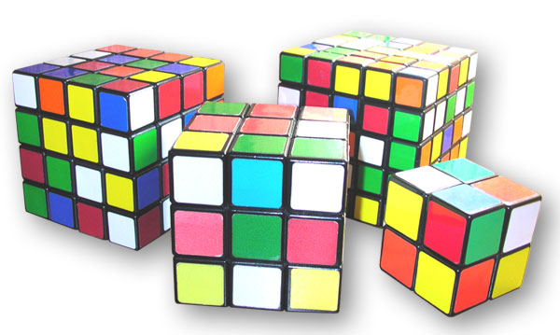
Variations

Slide 8
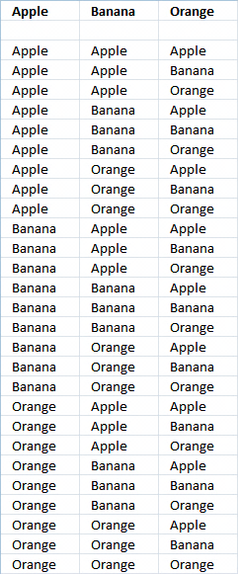
Variations
Variations (with repetition)
Choose k items (ordered) from a collection of n items, with repetition
Looks like k nested loops from 1 to n
When you have n things to choose from, you have n choices each time
When choosing k of them, the variations are:
n × n × ... × n (k times)
V(n, k) = n^{k}

Slide 9
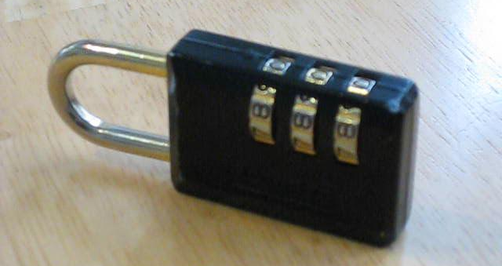
Variations (2)
Example: in the lock below, there are 10 numbers to choose from {0, 1, …, 9} and you choose 3 times some of them:
10 × 10 × 10 (3 times) = 10³ = 1 000 variations
All variations from {0, 0, 0} to {9, 9, 9}

Slide 10
Algorithm: Variations with Repetition
Algorithm Var(index) to generate variations V(n, k)
Put the numbers 0 … n-1 at position index
Call Var(index + 1) to generate the rest of the array
Var(0)
Var(1)
Var(k)
Print();
Stop!
0…n-1 | x | x | x | x
→
y | 0…n-1 | x | x | x
…
Var(1)
Var(2)

Slide 11
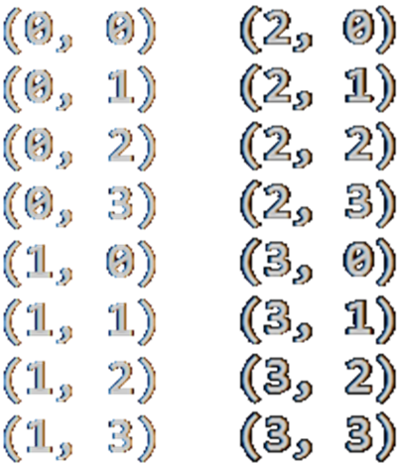
Generating Variations with Repetition
void GenerateVariations(int index)
{
if (index >= k)
{
Print(arr);
}
else
for (int i = 0; i < n; i++)
{
arr[index] = i;
GenerateVariations(index + 1);
}
}
int n = 4;
int k = 2;
int[] arr = new int[k];
GenerateVariations(0);

Slide 12


Variations: Iterative Algorithm
Iterative algorithm to generate variations V(n, k) with repetition, in lexicographical order
Start from { 0, 0, …, 0 }
Increment the last element
If the last element reaches its maximum, i.e. n-1
Make it 0 and increment the element of the left
If the element on the left reaches its maximum
Make it 0 and increment the element on the left, etc.
Repeat until all elements reach their maximums

Slide 13
Generating Variations Iteratively – Example
Generating the variations for n = 5 and k = 4
0 | 0 | 0 | 0
0 | 0 | 0 | 1
0 | 0 | 0 | 2
0 | 0 | 0 | 3
0 | 0 | 0 | 4
0 | 0 | 1 | 0
0 | 0 | 1 | 1
0 | 0 | 1 | 2
0 | 0 | 1 | 3
0 | 0 | 1 | 4
0 | 0 | 2 | 0
0 | 0 | 2 | 1
…
0 | 0 | 4 | 4
0 | 1 | 0 | 0
0 | 1 | 0 | 1
0 | 1 | 0 | 2
0 | 1 | 0 | 3
…
0 | 1 | 4 | 4
0 | 2 | 0 | 0
0 | 2 | 0 | 1
0 | 2 | 0 | 2
0 | 1 | 0 | 3
…
0 | 4 | 4 | 4
1 | 0 | 0 | 0
1 | 0 | 0 | 1
1 | 0 | 0 | 2
1 | 0 | 0 | 3
…
4 | 4 | 4 | 3
4 | 4 | 4 | 4
stop

Slide 14
Variations with Repetition – Iterative
while (true)
{
Print(arr);
int index = k - 1;
while (index >= 0 && arr[index] == n-1)
index--;
if (index < 0)
break;
arr[index]++;
for (int i = index + 1; i < k; i++)
arr[i] = 0;
}
int n = 5;
int k = 3;
int[] arr = new int[k];
(0, 0, 0)
(0, 0, 1)
…
(4, 4, 2)
(4, 4, 3)
(4, 4, 4)

Slide 15
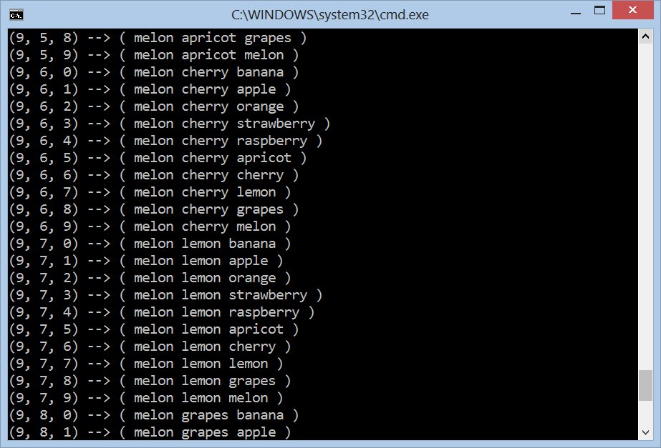
Generating Variations with Repetition
Live Demo

Slide 16
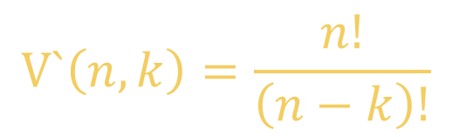
Variations without Repetition
Suppose we have 16 billiard balls
But maybe you don't want to choose them all, just 3 of them, so that would be only
16 × 15 × 14 = 3360
There are 3360 different ways that 3 pool balls could be selected out of 16 balls
16! / 13! = 16 × 15 × 14 = 3360
$$V`\left(n,k\right)=\frac{n!}{\left(n−k\right)!}$$
where n is the number of things to choose from, and you choose k of them (no repetition, order matters)

Slide 17

Variations without Repetition
Example:
How many words of 2 different letters can you make with 4 letters { a, b, c, d }?
How to generate variations without repetition?
The same way as variations with repetition
Ensure you use each element at most once
ab, ac, ad, ba, bc, bd, ca, cb, cd, da, db, dc

Slide 18
Algorithm: Variations without Repetition
Algorithm VarNoRep(index) to generate variations V`(n, k)
Put the unused numbers 0 … n-1 at position index
Call VarNoRep(index + 1) to generate the rest of the array
VarNoRep(0)
VarNoRep(1)
VarNoRep(k)
Print();
Stop!
0…n-1 | x | x | x | x
→
y | 0…n-1 | x | x | x
…
(unused number)
(unused number)
VarNoRep(1)
VarNoRep(2)

Slide 19
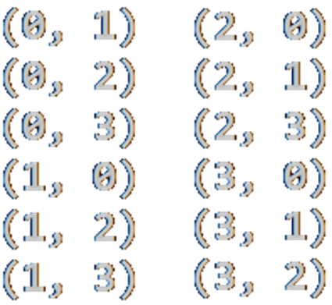
Generating Variations without Repetition
void VariationsNoRep(int index)
{
if (index >= k)
PrintVariations(arr);
else
for (int i = 0; i < n; i++)
if (!used[i])
{
used[i] = true;
arr[index] = i;
VariationsNoRep(index + 1);
used[i] = false;
}
}
int k = 2;
int n = 4;
int[] arr = new int[k];
bool[] used = new bool[n];
VariationsNoRep(0);

Slide 20
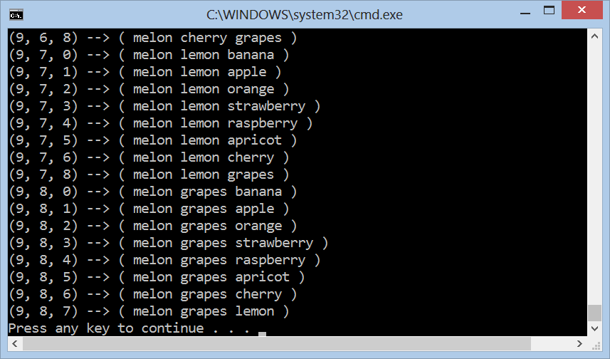
Variations without Repetition
Live Demo

Slide 21
Variations: a Better Algorithm
Checking whether a number is already used is slightly inefficient
Can we avoid this check and still avoid repetitions?
We can hold a set of free numbers to choose from at each step
VarNoRep(0)
VarNoRep(1)
VarNoRep(2)
VarNoRep(k)
Print();
Stop!
i | x | x | x | x
4 | i | x | x | x
4 | 1 | i | x | x
→
→
…
VarNoRep(1)
VarNoRep(2)
VarNoRep(3)
1 | 2 | 3 | 4 | 5
4
2 | 3 | 1 | 5
4 | 1
3 | 2 | 5
free
used
free
used
free

Slide 22
Better Algorithm: Variations (No Repeats)
void VarNoRep(int index)
{
if (index >= k)
Print(arr);
else
for (int i = index; i < n; i++)
{
arr[index] = free[i];
Swap(ref free[i], ref free[index]);
VarNoRep(index + 1);
Swap(ref free[i], ref free[index]);
}
}
int k = 3;
int n = 4;
int[] arr = new int[k];
int[] free = new int[n]
{ 1, 2, 3, 4 };
VarNoRep(0);

Slide 23

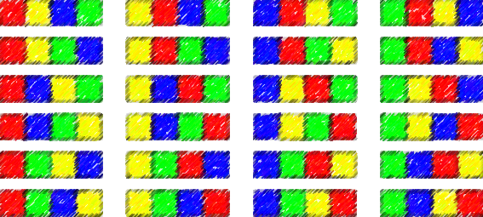

Permutations

Slide 24

Permutations
What order could 16 pool balls be in?
After choosing a ball (e.g. ball 9)
We can't choose the same ball again
First choice → 16 possibilities
Second choice → 15 possibilities
Third choice → 14 possibilities, etc.
Total permutations:
16 × 15 × 14 × … × 2 × 1 = 16! = 20 922 789 888 000

Slide 25
Algorithm: Permutations
Algorithm Perm(k) to permute the elements [k … n-1]:
Exchange the item at position k with the items at position k … n-1
Call Perm(k + 1) to permute the rest of the array
Perm(0)
Perm(1)
Perm(n)
Print();
Stop!
→
…
y | x | x | x | x | x | x
y | z | x | x | x | x | x
Perm(1)
Perm(2)

Slide 26
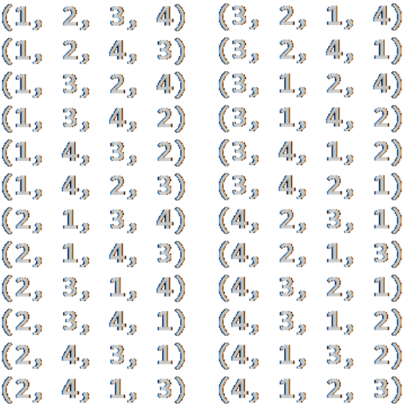
Generating Permutations
static void Perm<T>(T[] arr, int k)
{
if (k >= arr.Length)
Print(arr);
else
{
Perm(arr, k + 1);
for (int i = k + 1; i < arr.Length; i++)
{
Swap(ref arr[k], ref arr[i]);
Perm(arr, k + 1);
Swap(ref arr[k], ref arr[i]);
}
}
}
var arr = new int[]
{ 1, 2, 3, 4 };
Perm(arr, 0);

Slide 27
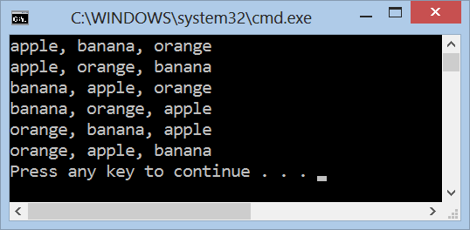
Generating Permutations
Live Demo

Slide 28
Permutations with Repetition
We have a set of elements, with repetition
E. g. set = { 3, 5, 1, 5, 5 }
We want to generate all unique permutations (without duplicates):
{ 1, 3, 5, 5, 5 } { 1, 5, 3, 5, 5 } { 1, 5, 5, 3, 5 } { 1, 5, 5, 5, 3 }
{ 3, 1, 5, 5, 5 } { 3, 5, 1, 5, 5 } { 3, 5, 5, 1, 5 } { 3, 5, 5, 5, 1 }
{ 5, 1, 3, 5, 5 } { 5, 1, 5, 3, 5 } { 5, 1, 5, 5, 3 } { 5, 3, 1, 5, 5 }
{ 5, 3, 5, 1, 5 } { 5, 3, 5, 5, 1 } { 5, 5, 1, 3, 5 } { 5, 5, 1, 5, 3 }
{ 5, 5, 3, 1, 5 } { 5, 5, 3, 5, 1 } { 5, 5, 5, 1, 3 } { 5, 5, 5, 3, 1 }
We want to efficiently avoid the repeating ones
i.e. to work fast for { 1, 5, 5, 5, 5, 5, 5, 5, 5, 5, 5, 5, 5, 5, 5, 5, 5, 5, 5, 5}

Slide 29
Algorithm: Permutations with Repetition
Algorithm PermRep(s, e) permutes the items [s … e]
Exchange the item at positions l = k … n-2 with items at l … n-1
Call PermRep(l + 1) to permute the rest of the array
PermRep(0, n-1)
PermRep(2, n-1)
PermRep(n-1, n-1)
s
l
s
l
Stop!
→
…
y | x | l | x | x | x
z | y | x | l | x | x
PermRep(l+1, n-1)
PermRep(l+1, n-1)
More info: http://hardprogrammer.blogspot.bg/2006/11/permutaciones-con-repeticin.html

Slide 30
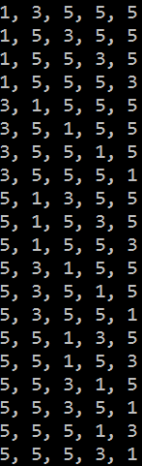
Generating Permutations with Repetition
static void PermuteRep(int[] arr, int start, int end)
{
Print(arr);
for (int left = end - 1; left >= start; left--)
{
for (int right = left + 1; right <= end; right++)
if (arr[left] != arr[right])
{
Swap(ref arr[left], ref arr[right]);
PermuteRep(arr, left + 1, end);
}
var firstElement = arr[left];
for (int i = left; i <= end - 1; i++)
arr[i] = arr[i + 1];
arr[end] = firstElement;
}
}
var arr = new int[] {3, 5, 1, 5, 5};
Array.Sort(arr);
PermuteRep(arr, 0, arr.Length-1);

Slide 31
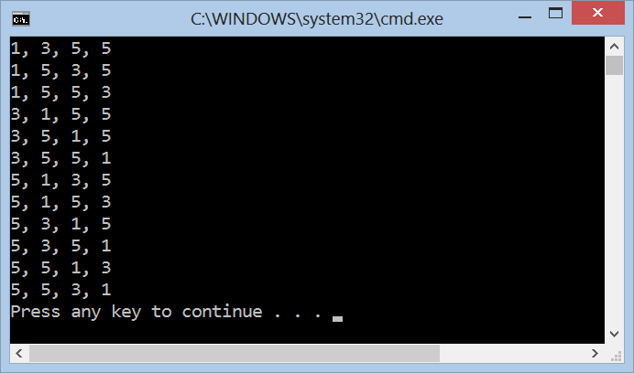
Generating Permutations with Repetition
Live Demo

Slide 32
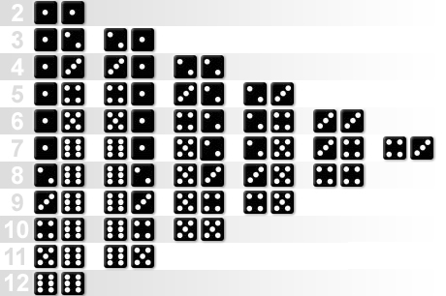
Combinations

Slide 33
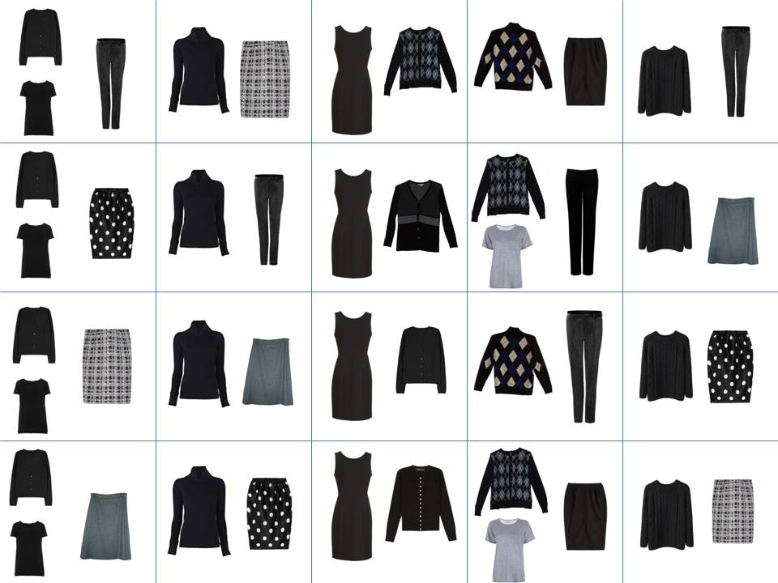
Combinations
Combinations → order does not matter!
Two types of combinations:
Combinations with repetition
E.g. coins in your pocket
5, 5, 20, 20, 20, 10, 10
Combinations with no repetition
Lottery numbers
TOTO 6/49, 6/42, 5/35
2, 14, 15, 27, 30, 33

Slide 34

Combinations without Repetition
Back to the 3 of 16 billiard balls
Many combinations will be the same
We don't care about the order
Ways to choose k items from set of n items
Often called "n choose k" (Google it!)
This is how lotteries work, e.g. TOTO 6/49
Order matters | Order does not matter
1 2 3 1 3 2 2 1 3 2 3 1 3 1 2 3 2 1 | 1 2 3
1 2 4 1 4 2 2 1 4 2 4 1 4 1 2 4 2 1 | 1 2 4
$$C(n, k)=\left({n \atop k}\right)=\frac{n!}{\left(n−k\right)!k!}$$

Slide 35
Algorithm: Combinations without Repetition
Algorithm Comb(index, start) to generate variations C(n, k)
Put the numbers i = start … n-1 at position index
Call Comb(index + 1, i + 1) to generate the rest of the array
Comb(0, start)
Comb(1, start)
Comb(k, start)
Print();
Stop!
i | x | x | x | x | x | x
→
y | i | x | x | x | x | x
…
Comb(1, i+1)
Comb(2, i+1)

Slide 36
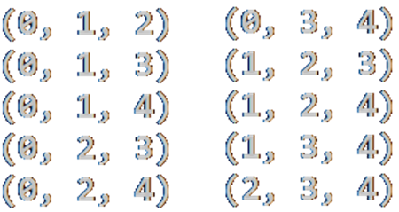
Generate Combinations without Repetition
void Comb(int index, int start)
{
if (index >= k)
{
PrintCombinations();
}
else
for (int i = start; i < n; i++)
{
arr[index] = i;
Comb(index + 1, i + 1);
}
}
int k = 3;
int n = 5;
int[] arr = new int[k];
Comb(0, 0);

Slide 37
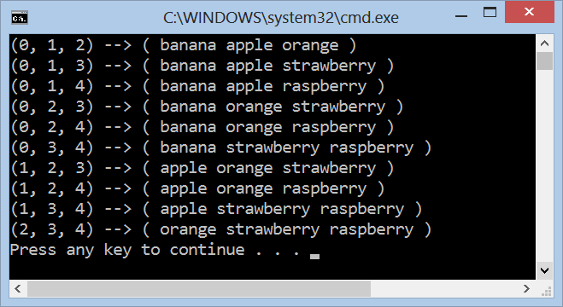
Generating Combinations without Repetition
Live Demo

Slide 38
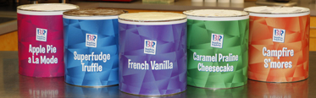
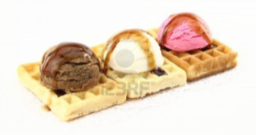

Combinations with Repetition
Ice-cream example
5 flavors of ice-cream: banana, chocolate, lemon, strawberry and vanilla
3 scoops
How many combinations will there be?
$$C′(n, k)=\left({n+k−1 \atop k}\right)=\left({n+k−1 \atop n−1}\right)=\frac{\left(n+k−1\right)!}{\left(n−1\right)!k!}$$

Slide 39
Algorithm: Combinations with Repetition
Algorithm Comb(index, start) to generate variations C'(n, k)
Put the numbers i = start … n-1 at position index
Call Comb(index + 1, i) to generate the rest of the array
CombRep(0, start)
CombRep(1, start)
CombRep(k, start)
Print();
Stop!
i | x | x | x | x | x | x
→
y | i | x | x | x | x | x
…
CombRep(1, i)
CombRep(2, i)

Slide 40
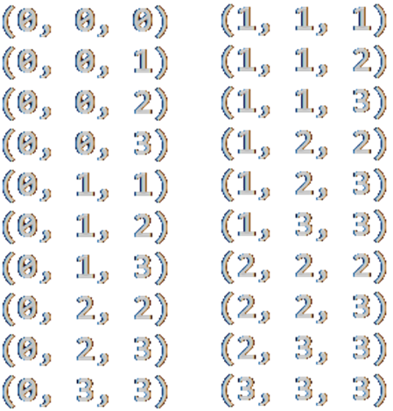
Generate Combinations with Repetition
void Comb(int index, int start)
{
if (index >= k)
{
PrintCombinations();
}
else
for (int i = start; i < n; i++)
{
arr[index] = i;
Comb(index + 1, i);
}
}
int k = 3;
int n = 4;
int[] arr = new int[k];
Comb(0, 0);

Slide 41
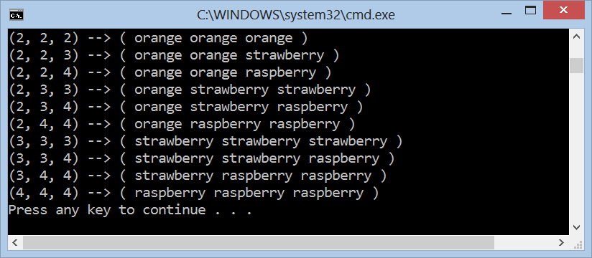
Generating Combinations with Repetition
Live Demo

Slide 42
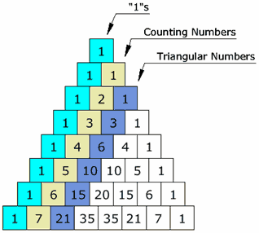


Binomial Coefficients and Pascal's Triangle

Slide 43

Binomial Coefficients
In combinatorics the binomial coefficients denote how many ways exist to choose k elements from a set of n elements
Binomial coefficients are the coefficients of the x ^{k} term in the polynomial expansion of the binomial power (1 + x) ^{n}
Arranged into rows, the Pascal's triangle is composed
$$C_{n}^{k}=\left({n \atop k}\right)=\frac{n!}{\left(n−k\right)!k!}$$
(1 + x) ⁴ = 1 + 4 x + 6 x ² + 4 x ³ + 1 x ⁴

Slide 44
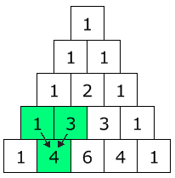

Pascal's Triangle
Pascal's triangle shows you how many combinations of objects without repetition are possible
Go down to row n (the top row is 0)
Move along k places
The value there is your answer
Build the triangle:
Start with "1" at the top
Then continue placing numbers below it in a triangular pattern
$$C_{n}^{k}=\left({n \atop k}\right)=\frac{n!}{\left(n−k\right)!k!}$$

Slide 45
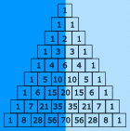
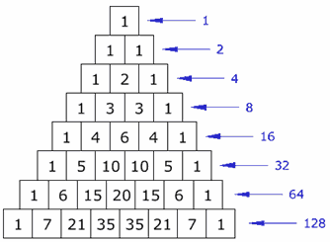
Pascal's Triangle's (2)
The Pascal's triangle is symmetrical
Numbers on the left side have identical matching numbers on the right side, like a mirror image
Diagonals:
First diagonal – only "1"s
Second diagonal – 1, 2, 3, etc.
Third diagonal – triangular numbers
Horizontal sums: powers of 2

Slide 46
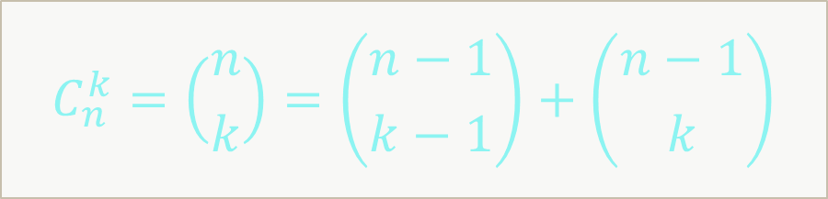
Binomial Coefficients: Recursive (Slow!)
decimal BinomSlow(int n, int k)
{
if (k > n)
return 0;
if (k == 0 || k == n)
return 1;
return Binom(n - 1, k - 1) + Binom(n - 1, k);
}
$$C_{n}^{k}=\left({n \atop k}\right)=\left({n−1 \atop k−1}\right)+\left({n−1 \atop k}\right)$$

Slide 47
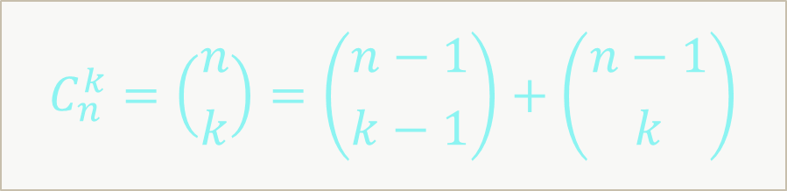
Binomial Coefficients: Recursive Calculation
const int MAX = 100;
static decimal[,] binomCoeff = new decimal[MAX, MAX];
static decimal Binom(int n, int k)
{
if (k > n)
return 0;
if (k == 0 || k == n)
return 1;
if (binomCoeff[n, k] == 0)
binomCoeff[n, k] = Binom(n - 1, k - 1) + Binom(n - 1, k);
return binomCoeff[n, k];
}
$$C_{n}^{k}=\left({n \atop k}\right)=\left({n−1 \atop k−1}\right)+\left({n−1 \atop k}\right)$$

Slide 48
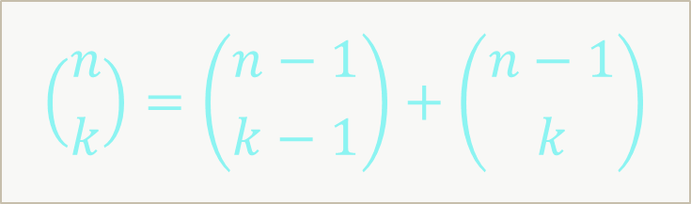
Pascal's Triangle: Bottom Up Calculation
int n = 10;
var pascal = new decimal[n + 1];
for (int row = 0; row <= n; row++)
{
for (int col = row; col >= 0; col--)
{
if (col == 0 || col == row)
pascal[col] = 1;
else
pascal[col] = pascal[col] + pascal[col - 1];
Console.Write(pascal[col] + " ");
}
Console.WriteLine();
}
$$\left({n \atop k}\right)=\left({n−1 \atop k−1}\right)+\left({n−1 \atop k}\right)$$

Slide 49
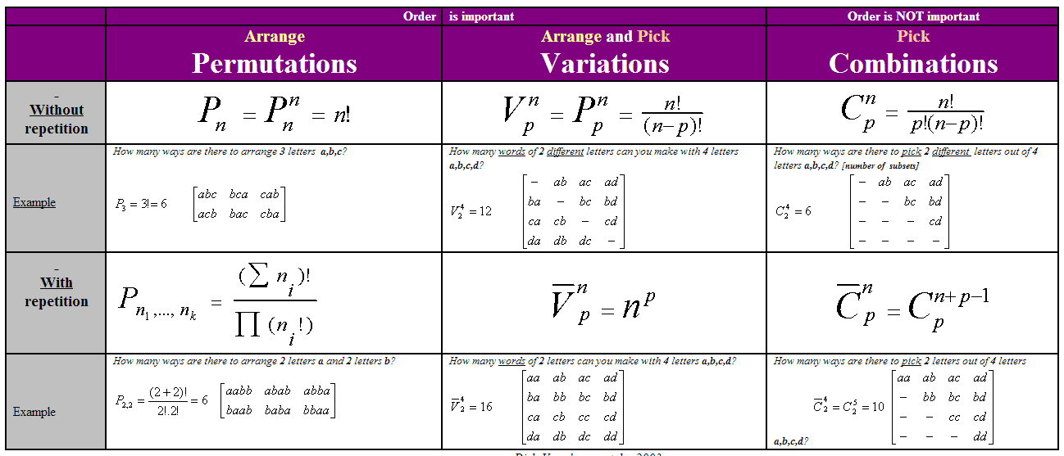
Combinatorial Formulas
Source: http://users.telenet.be/vdmoortel/dirk/Maths/PermVarComb.html

Slide 50
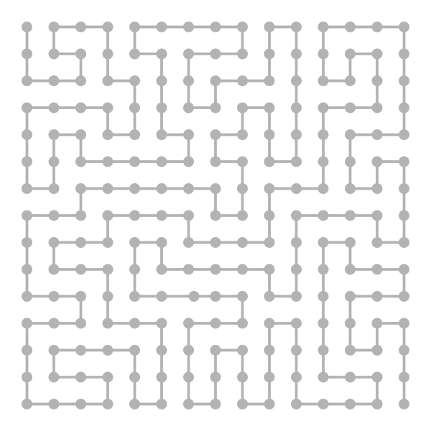
Binary Vectors

Slide 51
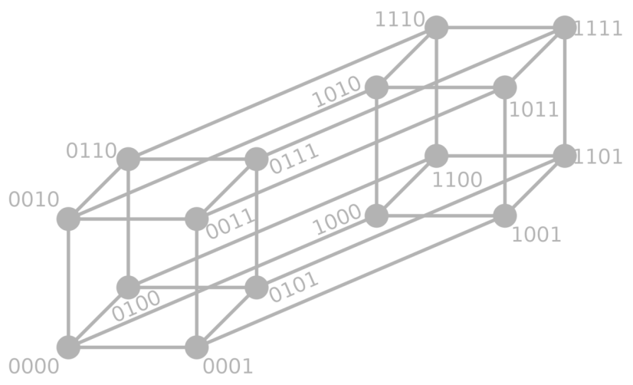
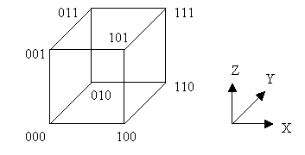
Binary Vectors
Some problems can be reformulated in terms of binary vectors
E. g. generate all subsets of given items – (1, 0, 1, 1, 1, 0, …)
Combinatorial properties of binary vectors:
Number of binary vectors of length n: 2^{n}
Number of binary vectors of length n and with k `1` is C(n, k)

Slide 52
Gray Code
Gray code by bit width
2-bit | 4-bit
00 01 11 10 | 0000 0001 0011 0010 0110 0111 0101 0100 1100 1101 1111 1110 1010 1011 1001 1000
3-bit
000 001 011 010 110 111 101 100
Gray code (a.k.a. reflected binary code)
A binary numeral system, where
Two successive values differ by only one bit
Decimal | Gray | Binary
0 | 000 | 000
1 | 001 | 001
2 | 011 | 010
3 | 010 | 011
4 | 110 | 100
5 | 111 | 101
6 | 101 | 110
7 | 100 | 111

Slide 53
Gray Code Generator – Source Code
void ForwardGray(int k)
{
if (k < 0)
{
Print();
}
else
{
arr[k] = 0;
ForwardGray(k - 1);
arr[k] = 1;
BackwardGray(k - 1);
}
}
void BackwardGray(int k)
{
if (k < 0)
{
Print();
}
else
{
arr[k] = 1;
ForwardGray(k - 1);
arr[k] = 0;
BackwardGray(k - 1);
}
}

Slide 54
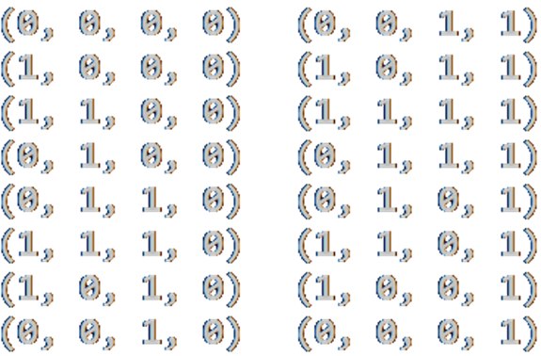
Gray Code Generator – Source Code (2)
const int n = 4;
static int[] arr = new int[n];
static void Main()
{
ForwardGray(n - 1);
}
static void Print()
{
Console.WriteLine("(" +
string.Join(", ", arr) +
")");
}

Slide 55
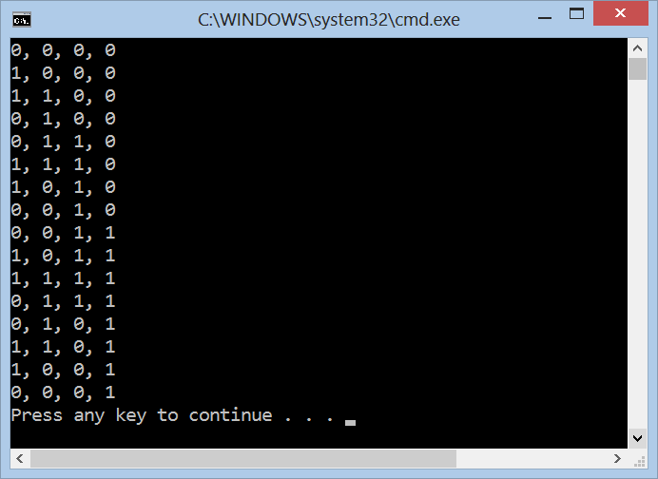
Gray Code
Live Demo

Slide 56


Summary
Recursive algorithms are powerful in generating combinatorial structures
Variations, permutations, combinations
With and without repetition
Binomial coefficients provide can compute the number of ways to choose k distinct elements from a set of n elements
Calculated by the Pascal's triangle
Gray code generates the binary vectors, so that two successive values differ in only one bit

Slide 57









Combinatorial Algorithms
https://softuni.bg/trainings/1194/Algorithms-September-2015

Slide 58
License
This course (slides, examples, labs, videos, homework, etc.) is licensed under the "Creative Commons Attribution-NonCommercial-ShareAlike 4.0 International" license
Attribution: this work may contain portions from
"Fundamentals of Computer Programming with C#" book by Svetlin Nakov & Co. under CC-BY-SA license
"Data Structures and Algorithms" course by Telerik Academy under CC-BY-NC-SA license

Slide 59






Free Trainings @ Software University
Software University Foundation – softuni.org
Software University – High-Quality Education, Profession and Job for Software Developers
softuni.bg
Software University @ Facebook
facebook.com/SoftwareUniversity
Software University @ YouTube
youtube.com/SoftwareUniversity
Software University Forums – forum.softuni.bg

